Slide 1
Unit 3
What is a memorandum?
A memorandum, or memo, is a document shared with a group of people to disperse information on a task, project, event, or other. The purpose of a memo is to bring immediate attention to that information in a quick and brief manner.
Memorandums are shared to inform readers about new information and have applications for different communities and businesses.
Communities can use memos to tell people within it about public safety guidelines, promote various events, raise awareness on subjects that affect their lives.
Businesses can use memos to relay information involving newly updated policy, changes in procedure, or persuade employees to take an action, such as attend an upcoming meeting, convention, or a celebration for organizational milestones.

Slide 2
How to Write a Memo
Write a heading.
Write an introduction.
Provide background on the issue
Outline action items and timeline.
Include a closing statement.
Review and proofread before sending.

Slide 3
Business Memo Template
MEMORANDUM
TO:
FROM:
DATE:
SUBJECT:
I'm writing to inform you that [reason for writing memo].
As our company continues to grow … [evidence or reason to support your opening paragraph].
Please let me know if you have any questions. In the meantime, I'd appreciate your cooperation as [official business information] takes place.

Slide 4
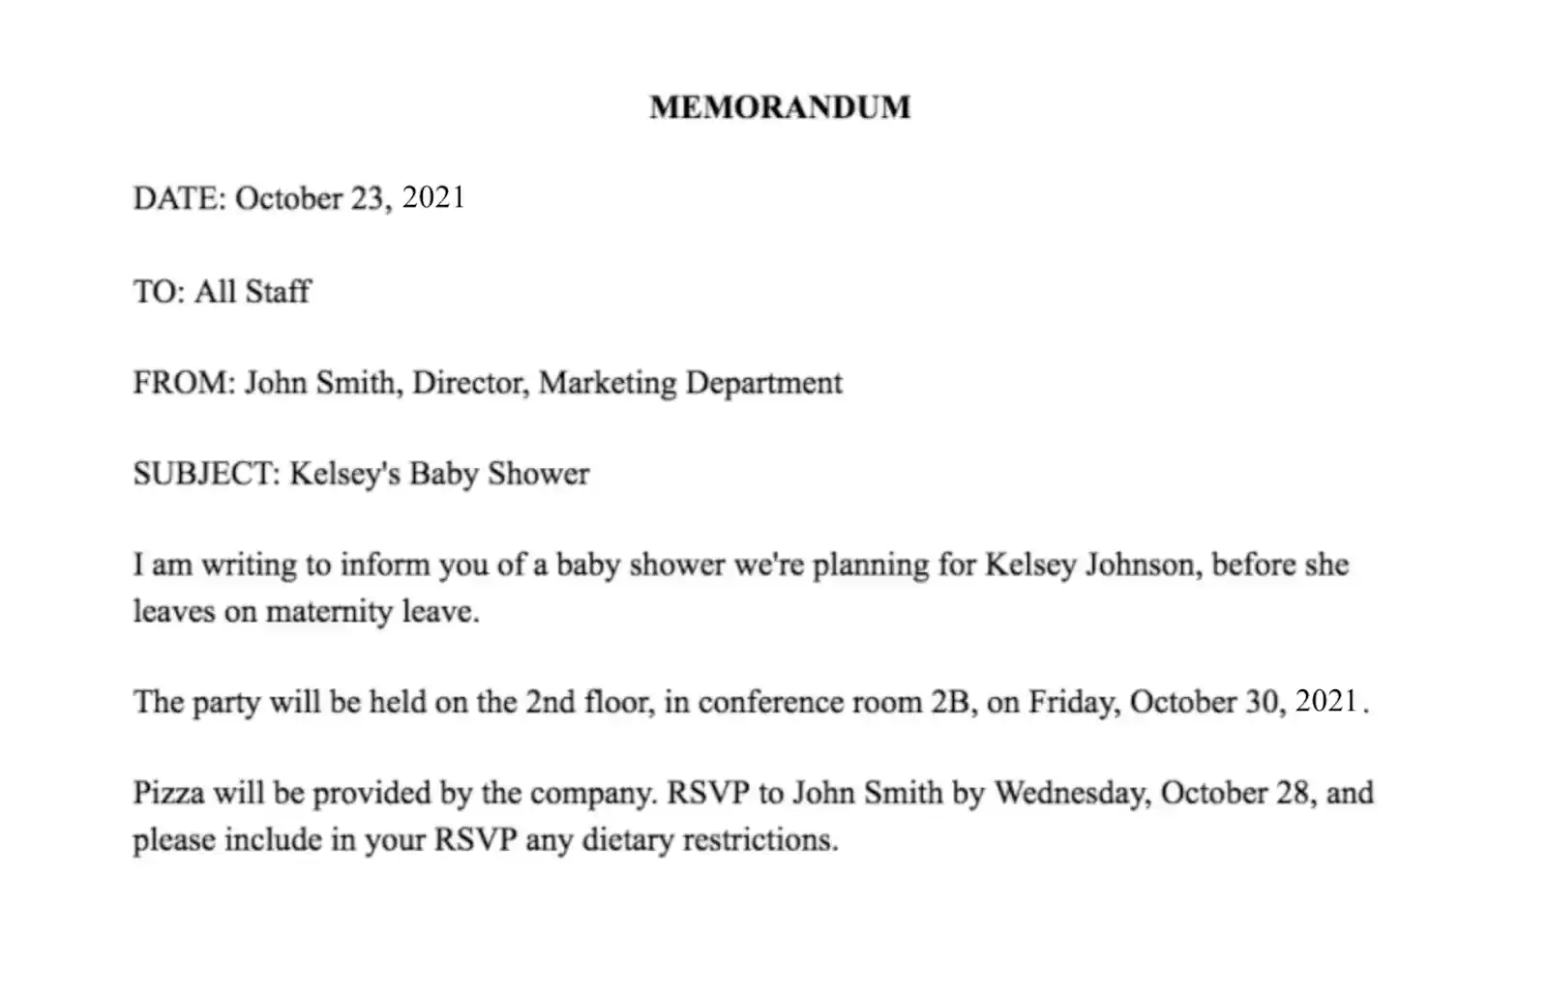

Slide 5
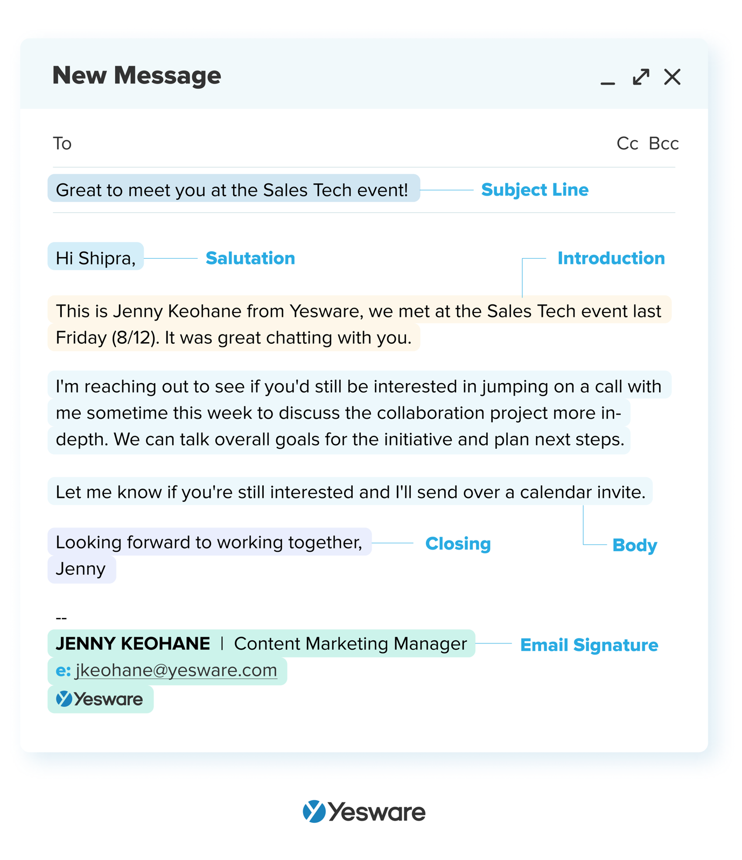
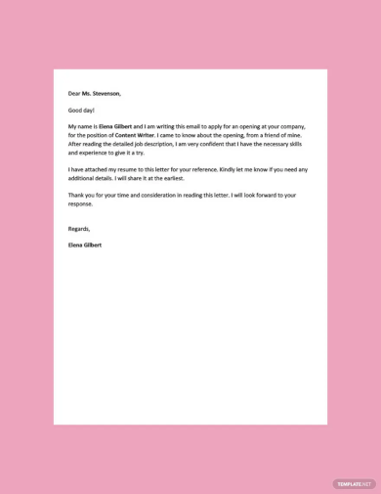

Slide 6
What is e mail etiquette?
Email etiquette refers to the set of rules and principles governing the proper conduct of email communication. It involves using appropriate language, tone, and format to convey a message effectively and professionally.
Why is Having Email Etiquette Important?
Having good email etiquette is important because it enhances communication, promotes professionalism, and avoids misunderstandings or conflicts. When emails are composed with proper etiquette, they convey a sense of respect, consideration, and efficiency, which can lead to improved relationships and productivity.

Slide 7
What are the Benefits of Having Email Etiquette?
The benefits of having good email etiquette are numerous, including improved communication, enhanced reputation, increased efficiency, and better relationships. Effective email communication can help to avoid misunderstandings or misinterpretations, which can lead to conflicts or lost opportunities. It also promotes professionalism and credibility, which can enhance one’s reputation and create positive impressions.
Businesses can improve email etiquette by establishing clear guidelines and standards for email communication. This can involve creating email templates, providing training on proper email etiquette, and monitoring emails for compliance with established standards. It can also involve setting expectations for response times and prioritizing emails based on their importance or urgency. Additionally, businesses can encourage the use of other communication channels when appropriate, such as phone calls or in-person meetings, to avoid over reliance on email.

Slide 8
Rules for email etiquette
Proofread every email you send. ...
Write your email before entering the recipient email address. ...
Double check you have the correct recipient. ...
Ensure you CC all relevant recipients. ...
You don't always have to "reply all" ...
Reply to your emails. ...
Include a signature block.

Slide 9
What are Some Examples of Proper Email Etiquette?
Some examples of proper email etiquette include addressing the recipient appropriately, using a clear and concise subject lines starting with a greeting, being concise and to the point, using appropriate language and tone, avoiding typos and grammatical errors, and ending with a closing remark.
The benefits of having good email etiquette are numerous, including improved communication, enhanced reputation, increased efficiency, and better relationships. Effective email communication can help to avoid misunderstandings or misinterpretations, which can lead to conflicts or lost opportunities. It also promotes professionalism and credibility, which can enhance one’s reputation and create positive impressions.

Slide 10
What are Examples of Bad Email Etiquette?
Not using a clear and concise subject line that accurately reflects the content of the email.
Failing to address the recipient by their proper name or title.
Using overly casual or unprofessional language or tone.
Writing long, rambling emails that lack a clear purpose or message.
Using excessive formatting, such as bold or italics, which can make the email difficult to read.
Not checking for typos or grammatical errors before sending the email.
Failing to respond to emails in a timely manner, or ignoring them altogether.
Sending large attachments without warning or without compressing them.
CC’ing or forwarding emails without permission, which can be seen as intrusive or disrespectful.
Using email to discuss sensitive or confidential information that should be kept private.
Also known as Email Manners and Email Protocol

Slide 11
Netiquette thus describes the rules of conduct for respectful and appropriate communication on the internet. Netiquette is often referred to as etiquette for the internet. These are not legally binding rules, but recommended rules of etiquette. Netiquette is mostly used for dealing with unknown people on the internet.
Netiquette rules:
Prioritize real people. ...
Stay considerate. ...
Don't overshare. ...
Respect other people's privacy. ...
Don't spam. ...
Respond quickly to emails and messages. ...
Help control flame wars. ...
Check for grammar and spelling mistakes.
Types of Netiquettes
E-mails, mailing lists, newsletters: Greetings, a polite address, as well as a correct spelling of the used words and phrases are a must. ...
Forums, chats and communities: Chats (chatiquette), forums, and communities often pay attention to respectful handling and correct technical use.

Slide 12
Questions
*Write a memo informing the decisions of a board meeting of your company. [5]
*Revise the following email so that it is grammatically and logically parallel. If some items don’t fit logically, take them out of the list and find a new place for them. [5]
Hi Dev, When you return from Birgunj, please bring the following for our meeting. The City of Birgunj Waste Management Manual (July 2022) The City of Birgunj Landfill site Construction 2022. Parks Development Guidelines, Province of Madhesh 2022;
Read the minutes from the last meeting. Some important stuff there. See if you can collect the responses of the locals of the proposed landfill construction site. Have fun on the red eye. Looking forward to seeing you at the meeting at 2 p. m., sharp.
*What do you understand by term netiquette? [5]

